Slide 1
8-1 Level Design Concepts
5CM503 Virtual Environment Development
Dr Patrick Merritt

Slide 2
Contents
Sight Lines
Corners

Slide 3
Sight Lines
Peek-a-boo! I kill you!

Slide 4
What is a sight line
A sight line (or line of sight) is the term used to describe what a player can see from a given position and situation within the game world.
Works backwards too… If I can see you, you can see me…
Allows us to control gameplay flow and map expected behaviour.

Slide 5
IMPORTANT!
Sightlines are not always modelled on human perception!
Players can have superhuman perception.
Or maybe perception is dictated by something else…
And just because you can see it does not mean you can interact with it…

Slide 6
Examples
<EQS Pawn>

Slide 7
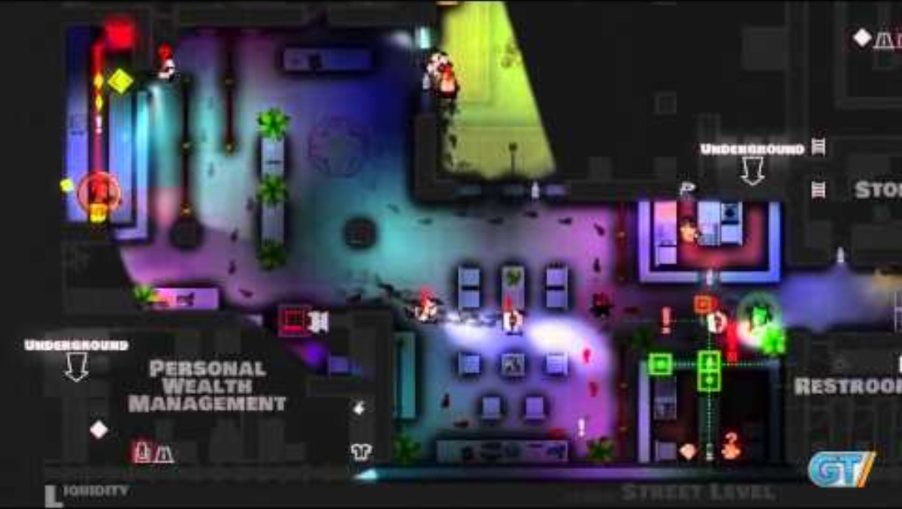
Can also be used as a game mechanic…

Slide 8
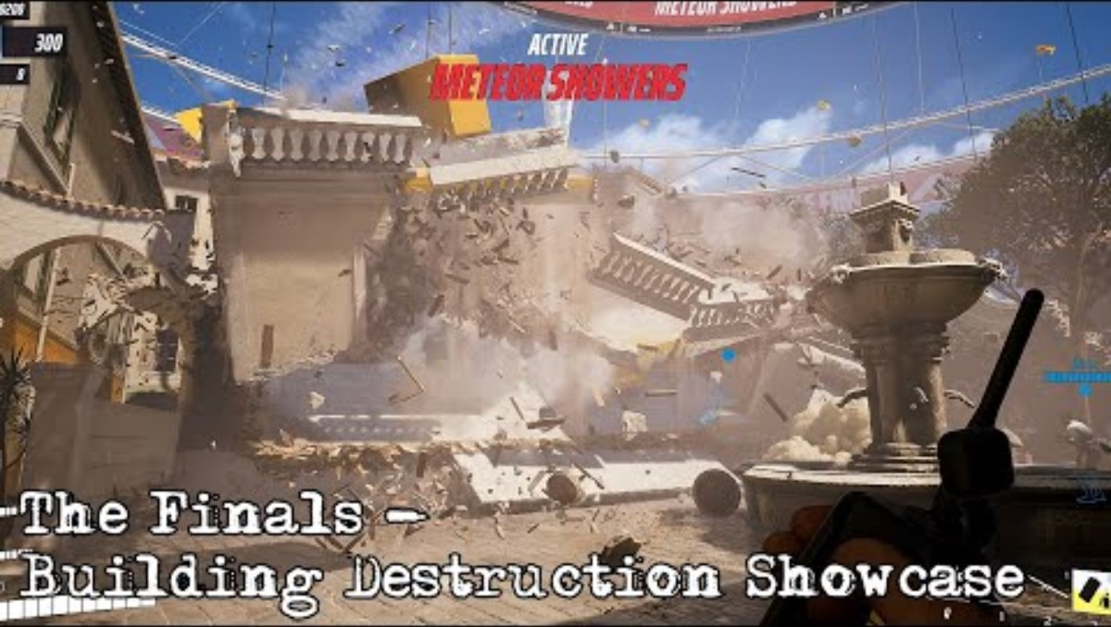
And can be inconsistent…

Slide 9
So, what are we trying to control?

Slide 10
Fair play

Slide 11
Fair play

Slide 12
Flow

Slide 13
Flow (circulation)

Slide 14
Flow (circulation)

Slide 15
Flow and narrative (critical path)

Slide 16
Flow and narrative (critical path)

Slide 17
Gameplay

Slide 18
Gameplay

Slide 19
Gameplay

Slide 20
Intensity

Slide 21
Intensity

Slide 22
Intensity

Slide 23
Corners
Subtle changes, big differences

Slide 24
FPS, Multiplayer, Two bad guys…

Slide 25
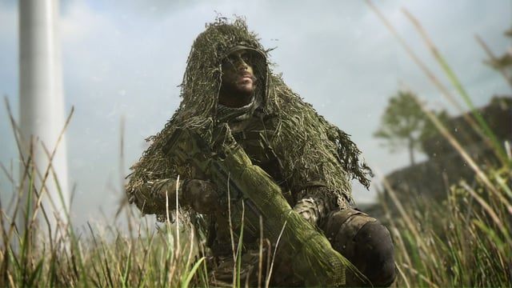
Pushers advantage…
Most games have soldiers being right handed…

Slide 26
Pushers advantage…
Most games have soldiers being right-handed…
Not a big deal, right?

Slide 27
Pushers advantage…
Most games have soldiers being right-handed…
Not a big deal, right?
In competitive games it is surprisingly important

Slide 28
FPS, Multiplayer, Two bad guys…

Slide 29
FPS, Multiplayer, Two bad guys…

Slide 30
FPS, Multiplayer, Two bad guys…
More Exposed…
Turning right is harder, pushers advantage is to the left.

Slide 31
Flow (circulation)

Slide 32
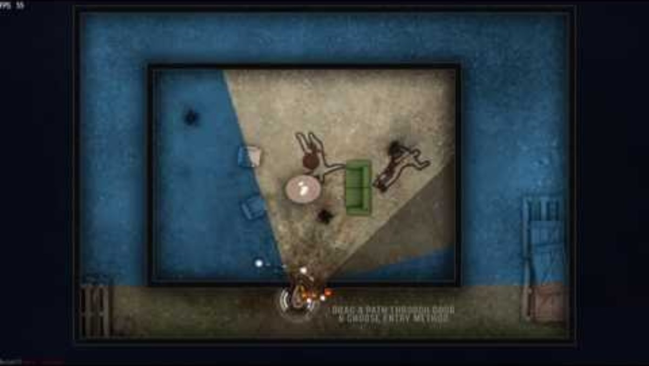
“Slicing the pie”

Slide 33
Types of corner
Hard 90
Restricts line of sight
Slows movement
Effective cover

Slide 34
Types of corner
Round 90
Opens the line of sight
Faster Movement
Less effective cover

Slide 35
Types of corner
Complex corners
Can be used to obstruct or protect the player
Open or close sight lines
Provide hardpoints or chokepoints depending on the situation.

